Slide 1
Budget Process
Financial Manager
Manpreet Kooner (AKA: Money)– msk28@psu.edu

Slide 2
Deadlines
Monday 11th week (October 30th ) by 5 PM
Reviewed 11th week
Emailed allocations Friday night of 11th week
Senate Votes on 13th week
Budgets turned in after deadline WILL NOT be accepted!

Slide 3
Needs
All necessary documents/forms (Ex. Budget Form)
http://bksga.psu.edu/documents/
Advisor Signature
Club President Signature
Receipts (when available)

Slide 4
Summary
Honoria (Presenters): 2 presenters totaling $5,000.00 per academic year ($2,500.00 per semester)
Clothing: $200.00 per semester
Program Materials (Prizes, decorations, etc.): $100.00 per semester
Food Expenses: $500.00 per event
Tickets: $15.00 per student for off-campus events
Travel: 75% of transportation cost or up to a total $1,000.00
Lodging (Hotels): $50.00 per student/per night
Registration: $75.00 per student per event
Equipment: $300.00 per academic year
Media: $250.00 per academic year
Operational: $50.00 per academic year
Maximum allocation: $5,000.00 per semester

Slide 5
Sample Budget

Slide 6
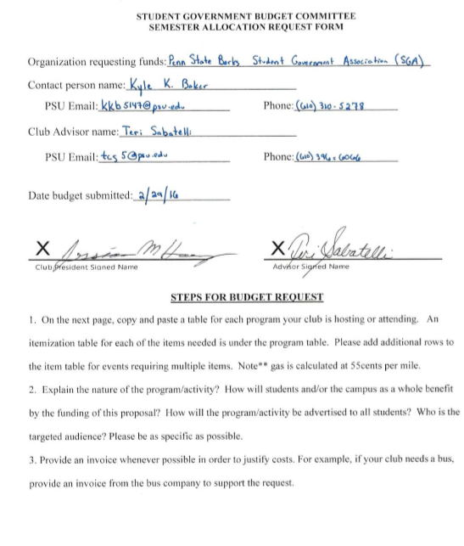

Slide 7
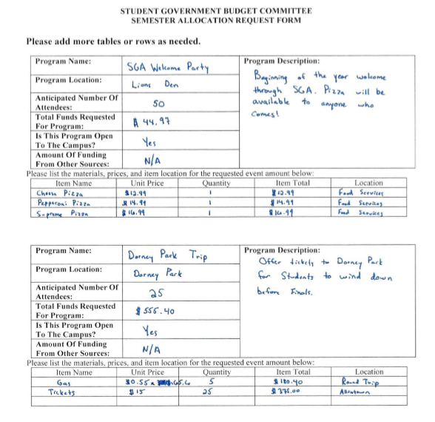

Slide 8
Documentation
Forms of Documentation:
Invoices
Quotes
Itemized Receipts
Food Services Menu
Webpage screenshot

Slide 9
Appeal Form

Slide 10
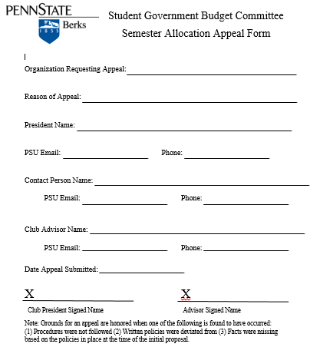

Slide 11
Sample Redistribution Form

Slide 12
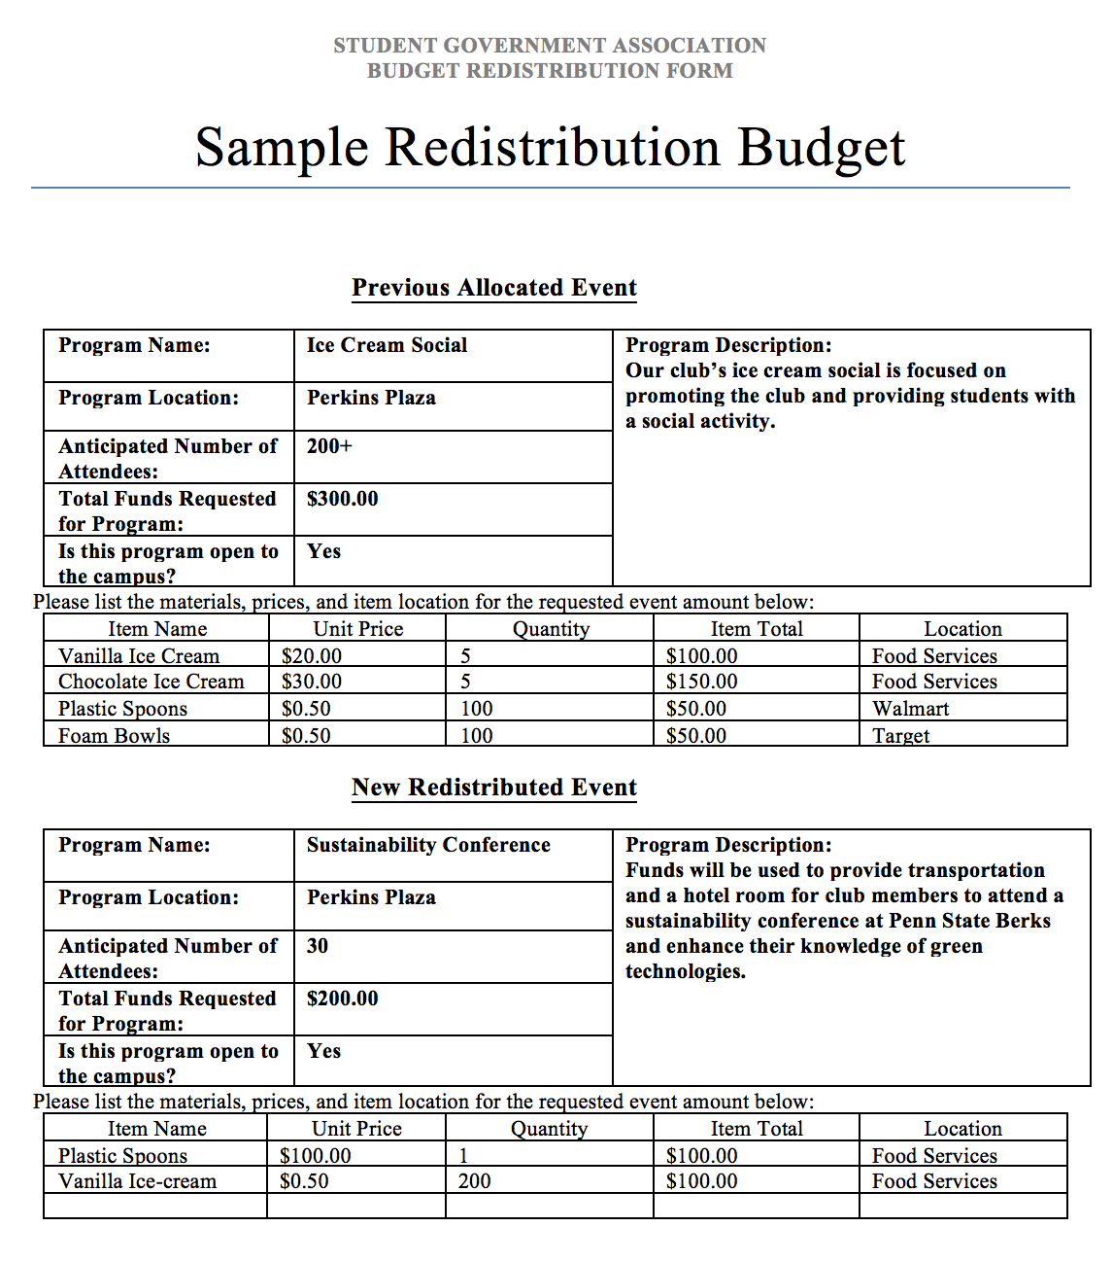

Slide 13
Sample Actual Expenditures

Slide 14
